Slide 1
Module - 5
Materials and Modelling

Slide 2
Classification of engineering material, Composition of Cast iron and Carbon steels, Alloy steels their applications, Definition of stress, strain and its types, Poisson’s ratio, Stress-strain diagram of ductile and brittle materials, Hooks law and modulus of elasticity, Mechanical properties like strength, hardness, toughness, ductility, brittleness, malleability etc. of materials,

Slide 3
Introduction
A large numbers of engineering materials exists in the universe such as metals and non metals (leather, rubber, asbestos, plastic, ceramics, organic polymers, composites and semi conductor).
Engineering materials may also be categorized into metals and alloys, ceramic materials, organic polymers, composites and semiconductors. The metal and alloys have tremendous applications for manufacturing the products required by the customers.

Slide 5
Metals and Alloys
https://www.youtube.com/watch?v=PaGJwOPg2kU

Slide 6
Metals are polycrystalline bodies consisting of a great number of fine crystals. Pure metals possess low strength and do not have the required properties.
So, alloys are produced by melting or sintering two or more metals or metals and a non-metal, together. Alloys may consist of two more components.
Metals and alloys are further classified into two major kind namely ferrous metals and non-ferrous metals.
(a) Ferrous metals are those which have the iron as their main constituent, such as pig iron, cast iron, wrought iron and steels.
(b) Non-ferrous metals are those which have a metal other than iron as their main constituent, such as copper, aluminium, brass, bronze, tin, silver zinc, invar etc.

Slide 7
Main Types of Iron
1. Pig iron
2. Cast iron
(A) White cast iron
(B) Gray cast iron
(C) Malleable cast iron
(D) Ductile cast iron
(E) Meehanite cast iron
(F) Alloy cast iron
3. Wrought iron
4. Steel
(A) Plain carbon steels
1. Dead Carbon steels
2. Low Carbon steels
3. Medium Carbon steels
4. High Carbon steels
(B) Alloy steels
1. High speed steel
2. Stainless steel

Slide 8
Cast Iron

Slide 9
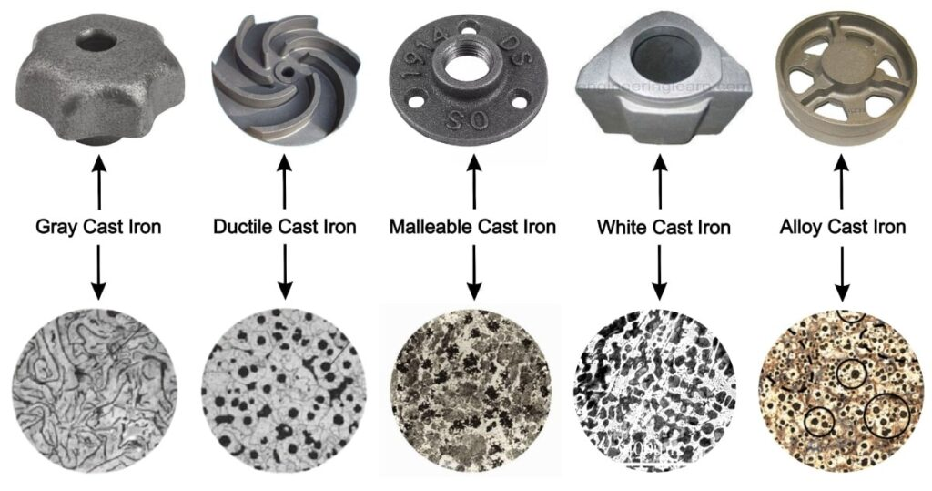

Slide 10
Cast iron is basically an alloy of iron and carbon and is obtained by re-melting pig iron with coke, limestone and steel scrap in a furnace known as cupola.
The carbon content in cast iron varies from 1.7% to 6.67%.
It also contains small amounts of silicon, manganese, phosphorus and Sulphur in form of impurities elements.
Cast iron is very brittle and weak in tension and therefore it cannot be used for making bolts and machine parts which are liable to tension. Since the cast iron is a brittle material and therefore, it cannot be used in those parts of machines which are subjected to shocks.

Slide 11
It has low cost, good casting characteristics, high compressive strength, high wear resistance and excellent machinability.
These properties make it a valuable material for engineering purposes. Its tensile strength varies from 100 to 200 MPa, compressive strength from 400 to 1000 MPa and shear strength is 120 MPa.
The compressive strength of cast iron is much greater than the tensile strength.

Slide 12

Grey cast iron
Grey cast iron is grey in color which is due to the carbon being principally in the form of graphite (C in free form in iron). It contains:
C = 2.5 to 3.8%.
Si = 1.1 to 2.8 %
Mn = 0.4 to 1.0%
P = less than 0.15%
S = less than 0.1%
Fe = Remaining
It is produced in cupola furnace by refining or pig iron.

Slide 13
Properties
When fractured it gives grey color.
It can be easily cast.
It can be easily machined and possesses machinability better than steel.
It possesses lowest melting of ferrous alloys.
It possesses high vibration damping capacity.
It has high resistance to wear.
It possesses high fluidity and hence can be cast into complex shapes and thin sections.
It possesses high compressive strength.
It has a low tensile strength.
It has very low ductility and low impact strength as compared with steel.
Applications
(i) Machine tool structures such as bed, frames, column etc.
(ii) Household appliances etc.
(iii) Gas or water pipes for under ground purposes.
(iv) Man holes covers.
(v) Piston rings.
(vi) Rolling mill and general machinery parts.
(vii) Cylinder blocks and heads for I.C. engines.
(viii) Frames of electric motor.
(ix) Ingot mould. And
(x) General machinery parts.
(xi) Sanitary wares.
(xii) Tunnel segment.

Slide 14

Steels

Slide 15
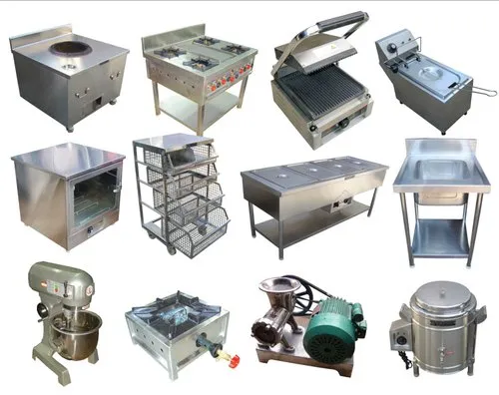

Slide 16


Slide 17
Steels
Steel is an alloy of iron and carbon with carbon content maximum up to 1.7%. The carbon occurs in the form of iron carbide, because of its ability to increase the hardness and strength of the steel.
Elements e.g. silicon, sulphur, phosphorus and manganese are also present to greater or lesser amount to import certain desired properties to it.
Most of the steel produced now-a-days is plain carbon steel.
Carbon steel has its properties mainly due to carbon content and does not contain more than 0.5% of silicon and 1.5% of manganese.

Slide 18
Plain carbon steel
Plain carbon steel is an alloy of iron and carbon. It has good machineability and malleability.
It is different from cast iron as regards the percentage of carbon. It contains carbon from 0.06 to 1.5% whereas cast iron possesses carbon from 1.8 to 4.2%.
Depending upon the carbon content, a plain carbon steels can divided to the following types:
1. Dead carbon steel — up to 0.15% carbon
2. Low carbon or mild steel — 0.15% to 0.45% carbon
3. Medium carbon steel — 0.45% to 0.8% carbon
4. High carbon steel — 0.8% to 1.5% carbon

Slide 19
Alloy Steels
For improving the properties of ordinary steel, certain alloying elements are added in it in sufficient amounts.
The most common alloying elements added to steel are chromium, nickel, manganese, silicon, vanadium, molybdenum, tungsten, phosphorus, copper, that the titanium, zirconium, cobalt, columbium, and aluminium.
Each of these elements induces certain qualities in steels to which it is added. They may be used separately or in combination to produce desired characteristics in the steel.
The main purpose of alloying element in steel is to improve machinability, elasticity, hardness, case hardening, cutting ability, toughness, wear resistance, tensile strength, corrosion resistance, and ability to retain shape at high temperature, ability to resist distortion at elevated temperature and to impart a fine grain size to steel.
Like carbon, a number of alloying elements are soluble to produce alloys with improved strength, ductility, and toughness. Also carbon, besides forming an inter-metallic compound with iron, combines with many alloying elements and form alloy carbides.

Slide 20
These steels are used for manufacturing
Axles,
Bolts,
Screws,
Nuts,
Special duty shafts,
Connecting rods,
Small and medium forgings,
Cold upset wires and rods,
Solid turbine rotors,
Rotor and gear shaft,
Forks and anchor bolts screw stock,
Spring clips,
Tubing, pipes, light weight rails, concrete reinforcing etc.

Slide 21
What is Stress?
Stress is defined as force per unit area within materials that arises from externally applied forces. By uneven heating, or permanent deformation and that permits an accurate description and prediction of elastic, plastic, and fluid behaviour. Stress is given by the following formula:
Stress (σ) = Force (F) /Area (A)
where, σ is the stress applied, F is the force applied and
A is the area of the force application.
The unit of stress is N/m2.

Slide 22
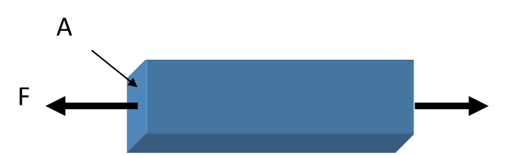

Slide 23
Classifying Loads on Materials
Normal Load (Axial load): Load is perpendicular to the supporting material.
Tension Load: As the ends of material are pulled apart to make the material longer, the load is called a tension load.
Compression Load: As the ends of material are pushed into make the material smaller, the load is called a compression load.
Torsion Loads: Angular distortion on a component, such as a shaft, when a moment is applied. (Twisting)
Thermal Loads: Distortion caused be heating or cooling a material. A normal load is created when the material is constrained in any direction in the plane that is constrained.

Slide 24
Tension
Compression
Shear Load : Tangential load
Pulling apart

Slide 25
Strain
- Ratio of elongation of a material to the original length
- unit deformation
Lo
e
e : elongation (mm)
Lo : unloaded(original) length of a material (mm)
: strain (mm/mm) - Unitless
L
Elongation:
L : loaded length of a material (mm)

Slide 26
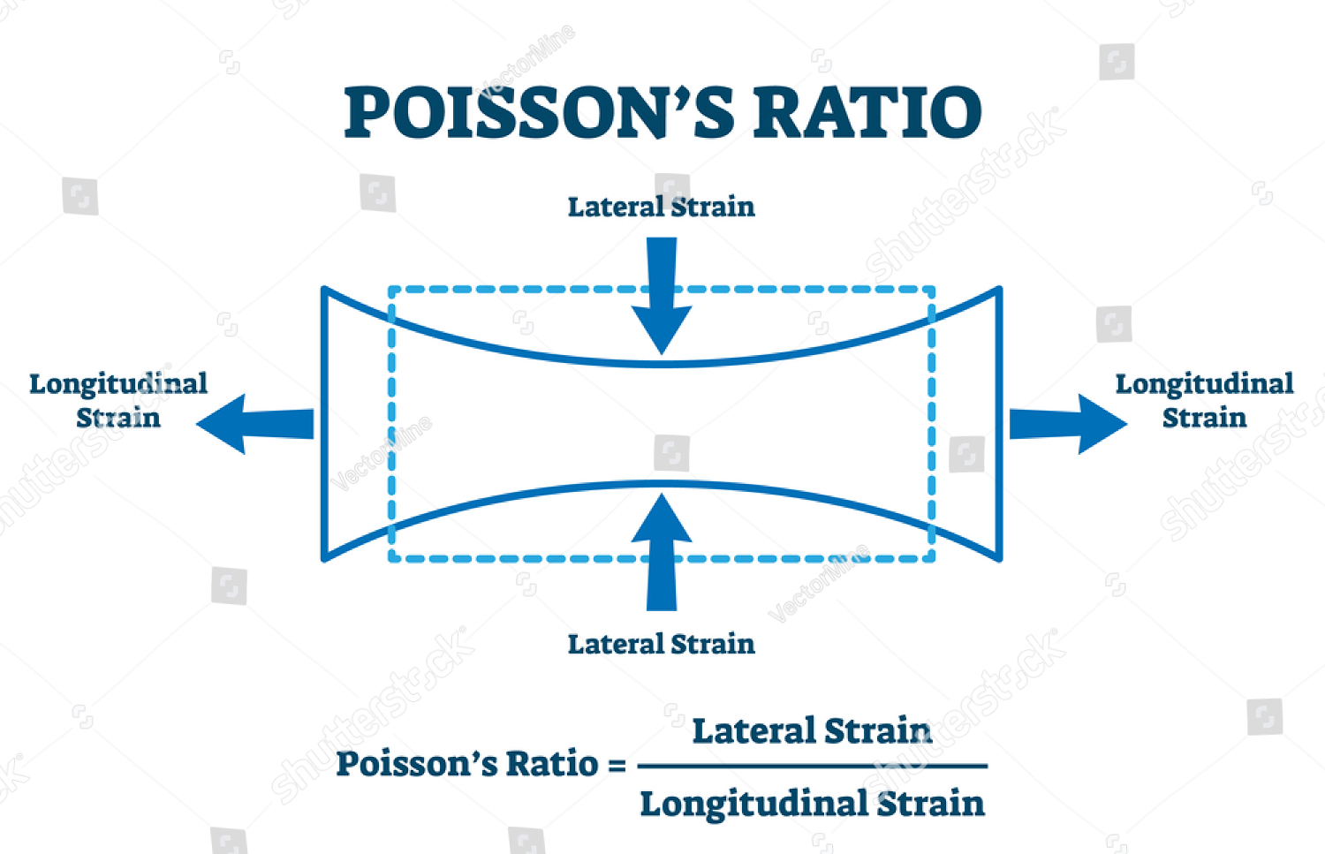
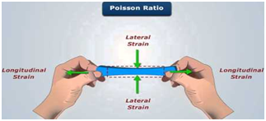

Slide 27
Longitudinal Strain
When a body is subjected to an axial tensile or compressive load, there is an axial deformation in the length of the body. The ratio of axial deformation to the original length of the body is known as longitudinal (or linear) strain. The longitudinal strain is also defined as the deformation of the body per unit length in the direction of the applied load.
Let L = Length of the body,
P = Tensile force acting on the body,
δL = Increase in the length of the body in the direction of P.
Then, longitudinal strain = δL /L

Slide 28
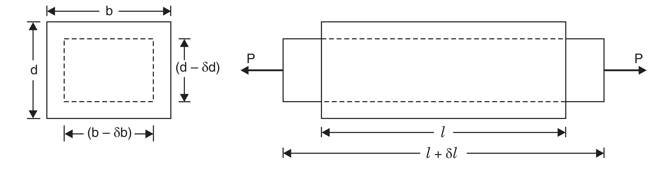
Lateral Strain
The strain at right angles to the direction of applied load is known as lateral strain. Let a rectangular bar of length L, breadth b and depth d is subjected to an axial tensile load P as shown in Fig. The length of the bar will increase while the breadth and depth will decrease.
Let δL = Increase in length,
δb = Decrease in breadth, and
δd = Decrease in depth.
lateral strain = δb/b or δd/d

Slide 29
Poisson’s Ratio
The ratio of lateral strain to the longitudinal strain is a constant for a given material, when the material is stressed within the elastic limit. This ratio is called Poisson’s ratio
and it is generally denoted by μ. Hence mathematically,
Poisson’s ratio, µ = Lateral strain / Longitudinal strain
or Lateral strain = µ × longitudinal strain
The value of Poisson’s ratio varies from 0.25 to 0.33. For rubber, its value ranges from 0.45 to 0.50.

Slide 30
The body will regain its previous shape and size only when the deformation caused by the external force, is within a certain limit. Thus there is a limiting value of force up to and within which, the deformation completely disappears on the removal of the force.
The value of stress corresponding to this limiting force is known as the elastic limit of the material.
If the external force is so large that the stress exceeds the elastic limit, the material loses to some extent its property of elasticity. If now the force is removed, the material will not return to its original shape and size and there will be a residual deformation in the material.
ELASTICITY AND ELASTIC LIMIT
When an external force acts on a body, the body tends to undergo some deformation. If the external force is removed and the body comes back to its original shape and size (which means the deformation disappears completely), the body is known as elastic body.
This property, by virtue of which certain materials return back to their original position after the removal of the external force, is called elasticity.

Slide 31
Hooke’s Law and Elastic Moduli.
Hooke’s Law states that when a material is loaded within elastic limit, the stress is proportional to the strain produced by the stress.
This means the ratio of the stress to the corresponding strain is a constant within the elastic limit. This constant is known as Modulus of Elasticity or Modulus of Rigidity or Elastic Moduli.
where σ = Normal stress, e = Strain and E = Young’s modulus

Slide 32
Modulus of Elasticity (or Young’s Modulus)..
The ratio of tensile stress or compressive stress to the corresponding strain is a constant. This ratio is known as Young’s Modulus or Modulus of Elasticity and is denoted by E.
Modulus of Rigidity or Shear Modulus.
The ratio of shear stress to the corresponding shear strain within the elastic limit, is known as Modulus of Rigidity or Shear Modulus. This is denoted by C or G or N.

Slide 33
Stress and Strain Diagram
For Ductile and Brittle Materials

Slide 34
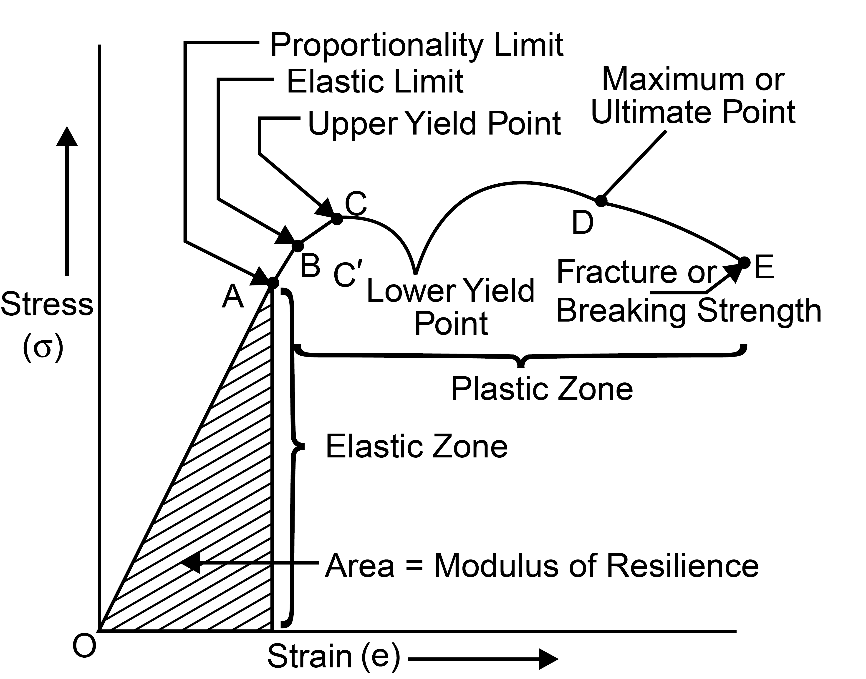
(a) Stress-Strain Curves for Ductile Materials
If a mild steel bar of uniform cross-sectional area is subjected to gradually increasing axial tensile force (generally is done in Universal Testing Machine) till failure of the bar occurs, and if we plot the graph for stress and strain, the following curve (Fig. 1.1) may be obtained:
Fig.1.1 : Stress – strain Diagram for Ductile Material

Slide 35
The curve may be divided into following parts:
Portion OA: This portion is absolutely straight, where the stress is proportional to strain and the material obeys Hooke’s law. The value of stress at point A is called proportional limit.
Portion AB: In this portion, Hook’s law is not obeyed, although the material may still be elastic. The point B indicates the elastic limit.
Portion BC: In this portion, the metal shows an appreciable strain even without further increase in stress and the strain is not fully recoverable when load is removed.
Portion CC': Yielding commences in this portion and there is a drop of stress at the point C' immediately after yielding commences at C. The point C' is termed as lower yield point and C is called upper yield point.

Slide 36
Portion C'D: After yielding has taken place at C', further straining takes place at this portion by increasing the stress and the stress–strain curve continues to rise up to the points D. Strain in this portion is about 100 times that of portion O to C. At the point D, the bar begins to form a local neck. The point D is termed as ultimate tensile stress point. Ultimate stress is calculated at this point.
Portion DE: In this portion, the load falling off from the maximum until fracture at E takes place. The point E is termed as fracture or breaking point and the corresponding stress is called breaking stress.

Slide 37
(b) Stress Strain Curves for Brittle Materials
Materials which show very small elongation before
they fracture are called brittle materials. The shape of curve for high carbon steel is shown in fig. and is typical of many brittle materials such as G.I., concrete and high strength light alloys. For most brittle materials the permanent elongation (i.e. increase in length) is less than 10%.
Fig. : Stress – strain Diagram for Brittle Material

Slide 38
Principal Mechanical Properties
Those characteristics of the materials which describe their behaviour under external loads are known as Mechanical Properties. The most important and useful mechanical properties are:
Strength
It is the resistance offered by a material when subjected to external loading. So, stronger the material the greater the load it can withstand. Depending upon the type of load applied the strength can be tensile, compressive, shear or torsional.
The maximum stress that any material will withstand before destruction is called its ultimate strength (Point D as shown in Fig. 1.1).
Elasticity
Elasticity of a material is its power of coming back to its original position after deformation when the stress or load is removed. Elasticity is a tensile property of its material.
The greatest stress that a material can endure without taking up some permanent set is called elastic limit (Point A as shown in Fig. 1.1.).

Slide 39
Principal Mechanical Properties
Stiffness (Rigidity)
The resistance of a material to deflection is called stiffness or rigidity. Steel is stiffer or more rigid than aluminium.
Stiffness is measured by Young’s modulus E. The higher the value of the Young’s modulus, the stiffer the material. E is the ratio of stress over strain and is given by the slope of line O–A.
Plasticity
The plasticity of a material is its ability to undergo some degree of permanent deformation without failure. Plastic deformation will take place only after the elastic range has been exceeded, beyond point b.
Plasticity is an important property and widely used in several mechanical processes like forming, shaping, extruding and many other hot and cold working processes.
In general, plasticity increases with increasing temperature and is a favorable property of material for secondary forming processes.
Due to this properties various metal can be transformed into different products of required shape and size. This conversion into desired shape and size is effected either by the application of pressure, heat or both.

Slide 40
Principal Mechanical Properties
Ductility
Ductility of a material enables it to draw out into thin wire on application of the load. Mild steel is a ductile material.
The wires of gold, silver, copper, aluminium, etc. are drawn by extrusion or by pulling through a hole in a die due to the ductile property.
The ductility decreases with increase of temperature.
The per cent elongation and the reduction in area in tension is often used as empirical measures of ductility.
Malleability
Malleability of a material is its ability to be flattened into thin sheets without cracking by hot or cold working.
Aluminium, copper, tin, lead, steel, etc. are malleable metals.
Lead can be readily rolled and hammered into thin sheets but can not be drawn into wire.
Ductility is a tensile property, whereas malleability is a compressive property. Malleability increases with increase of temperature.

Slide 41
Principal Mechanical Properties
Brittleness
The brittleness of a material is the property of breaking without much permanent distortion. There are many materials, which break or fail before much deformation take place. Such materials are brittle e.g., glass, cast iron.
Therefore, a non-ductile material is said to be a brittle material.
Usually the tensile strength of brittle materials is only a fraction of their compressive strength.
A brittle material should not be considered as lacking in strength.
It only shows the lack of plasticity. On stress-strain diagram, these materials don’t have yield point and value of E is small.

Slide 42
Principal Mechanical Properties
Toughness
The toughness of a material is its ability to withstand both plastic and elastic deformations. It is a highly desirable quality for structural and machine parts to withstand shock and vibration. Manganese steel, wrought iron, mild steels are tough materials.
For Ex: If a load is suddenly applied to a piece of mild steel and then to a piece of glass the mild steel will absorb much more energy before failure occurs. Thus, mild steel is said to be much tougher than a glass.
Toughness is a measure of the amount of energy a material can absorb before actual fracture or failure takes place. “The work or energy a material absorbs is called modulus of toughness” Toughness is also resistance to shock loading. It is measured by a special test on Impact Testing Machine.

Slide 43
Principal Mechanical Properties
Hardness
Hardness is closely related to strength. It is the ability of a material to resist scratching, abrasion, indentation, or penetration.
It is directly proportional to tensile strength and is measured on special hardness testing machines by measuring the resistance of the material against penetration of an indentor of special shape and material under a given load.
The different scales of hardness are Brinell hardness, Rockwell hardness, Vickers's hardness, etc.
Hardness of a metal does not directly relate to the hardenability of the metal.
Hardenability is indicative of the degree of hardness that the metal can acquire through the hardening process. i.e., heating or quenching.

Slide 44
Principal Mechanical Properties
Hardenability
Hardenability is the degree of hardness that can be imparted to metal by process of hardening.
A metal capable of being hardened throughout its structure is said to have high hardenability.
The material is heated above a certain temperature and then suddenly quenched in a cold oil or water bath.
Resilience
Resilience is the capacity of material to absorb energy elastically. On removal of the load, the energy stored is released as in a spring.
The maximum energy which can be stored in a body up to elastic limit is called the proof resilience.
The quantity gives capacity of the material to bear shocks and vibrations. The strain energy stored in a material of unit volume gives proof resilience and is measured by work stretching.

